Slide 1
MINI ATM PROJECT
----------------------------------------------------------------

Slide 2
INTERFACE
INTRODUCTION
CODING
OUTPUT
CONCLUSION
REFERENCE

Slide 3
INTRODUCTION
The ATM (Automated Teller Machine) Mini Project is a simplified simulation of a real-world banking system. It is designed to demonstrate the fundamental concepts of programming, including the use of structures, functions and control statements.
This project allows users to perform basic banking operations such as:
Creating a new bank account
Depositing money
Withdrawing money
Checking account balance
Viewing account details
The goal of this mini project is to provide a user-friendly interface where multiple accounts can be managed securely using a PIN-based authentication system. The project also emphasizes proper input validation and menu-driven interaction, enhancing the usability and functionality of the application.
This system mimics the actual working of an ATM in a simplified manner, making it an ideal learning project for beginners in programming.

Slide 4
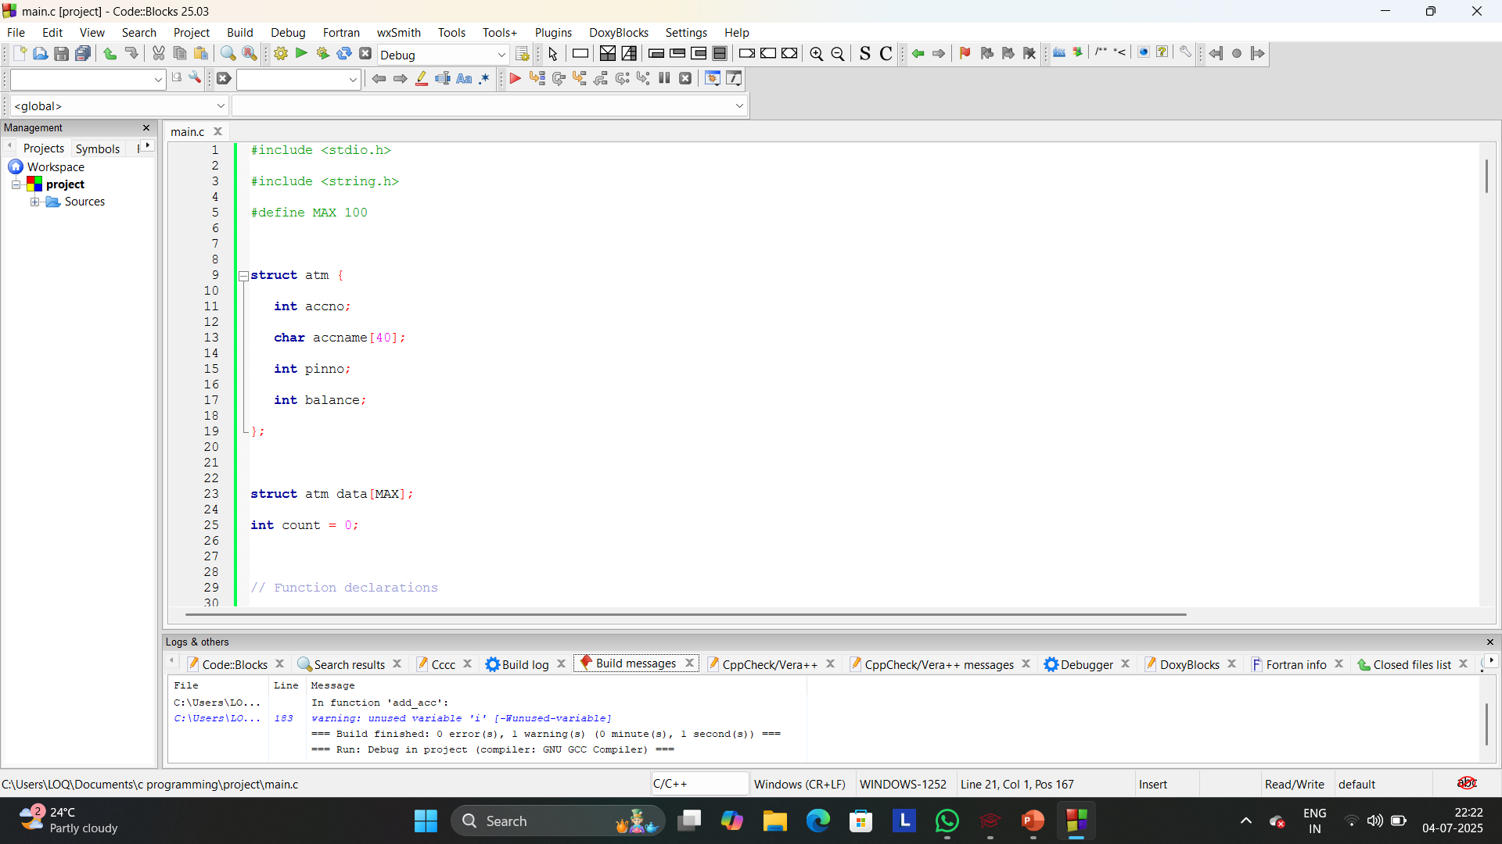
CODING

Slide 5
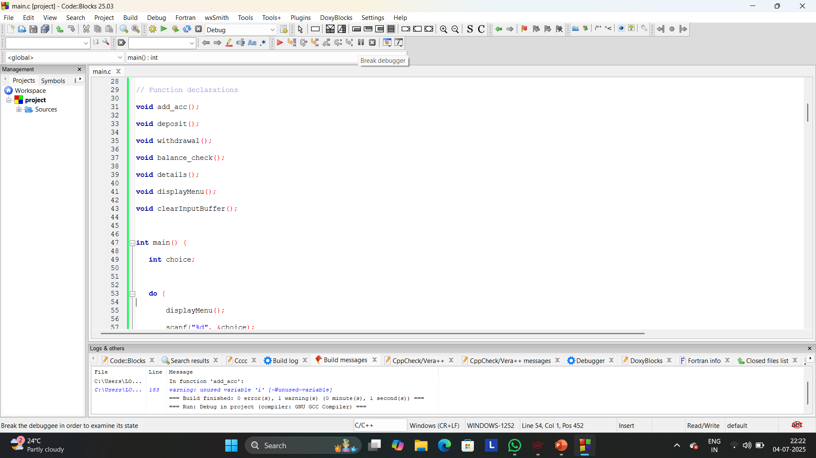

Slide 6
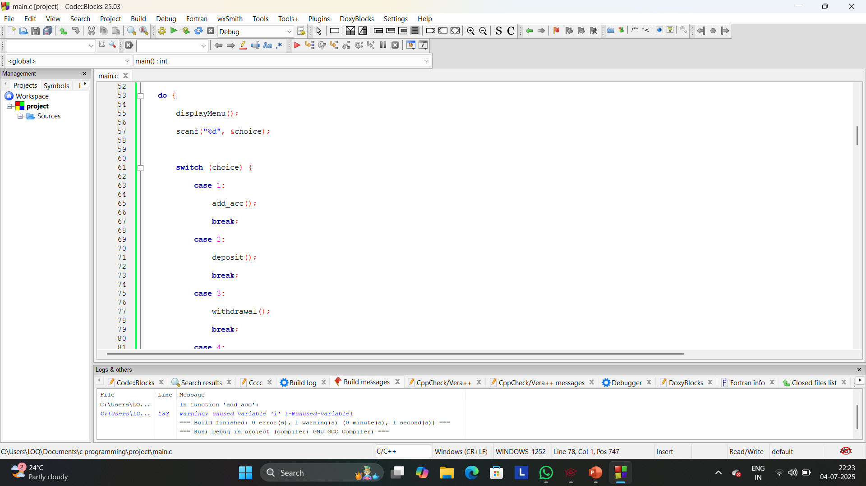

Slide 7
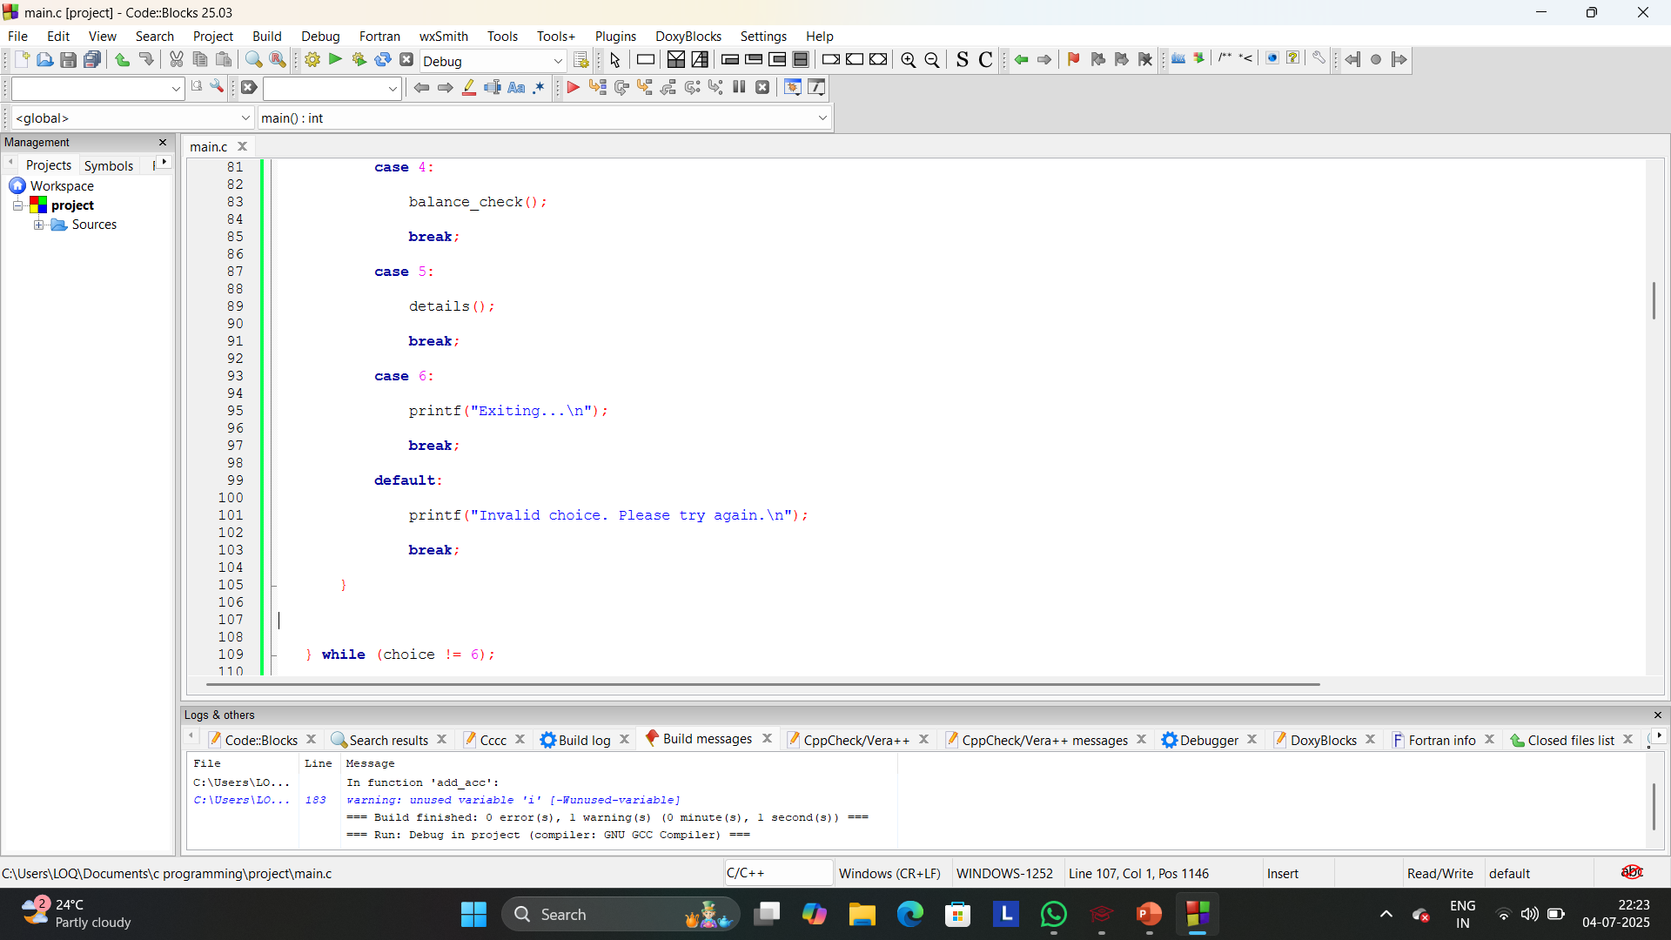

Slide 8
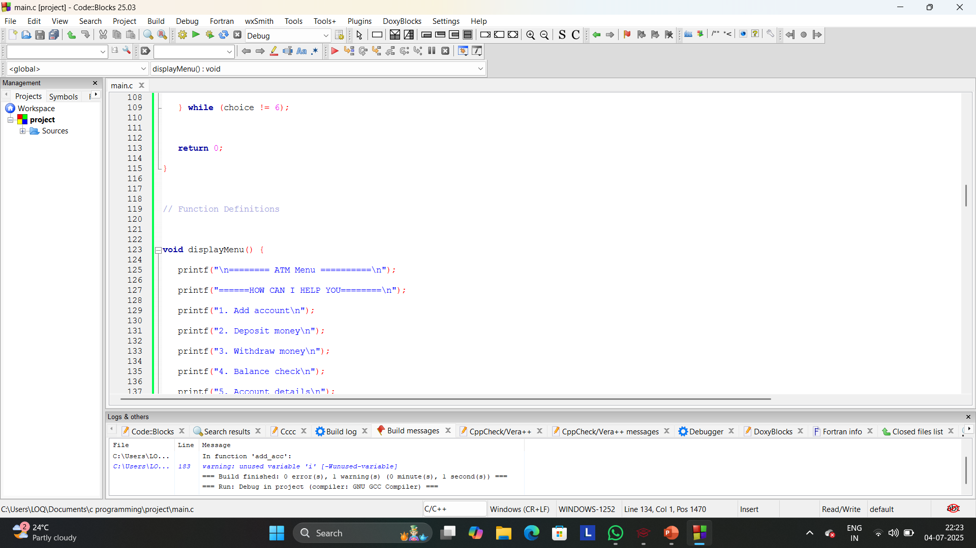

Slide 9
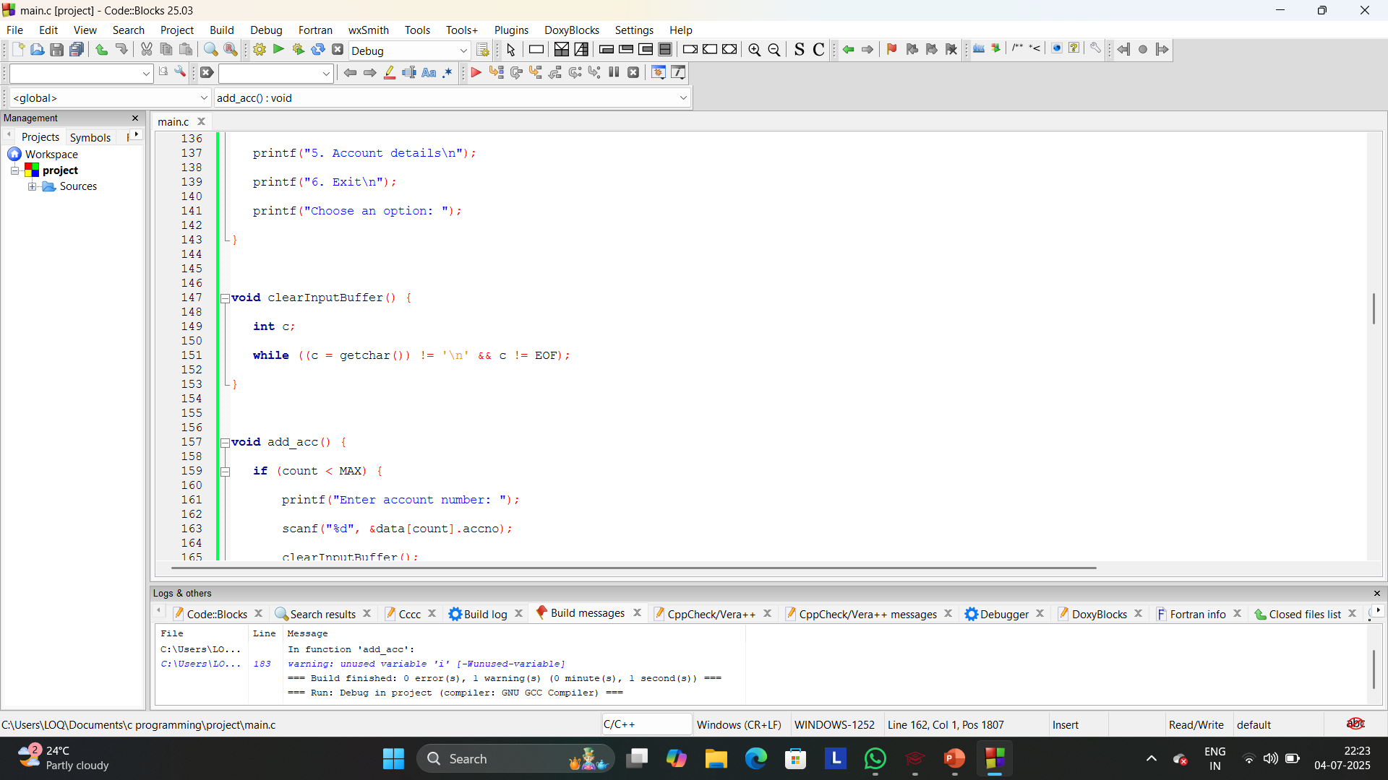

Slide 10
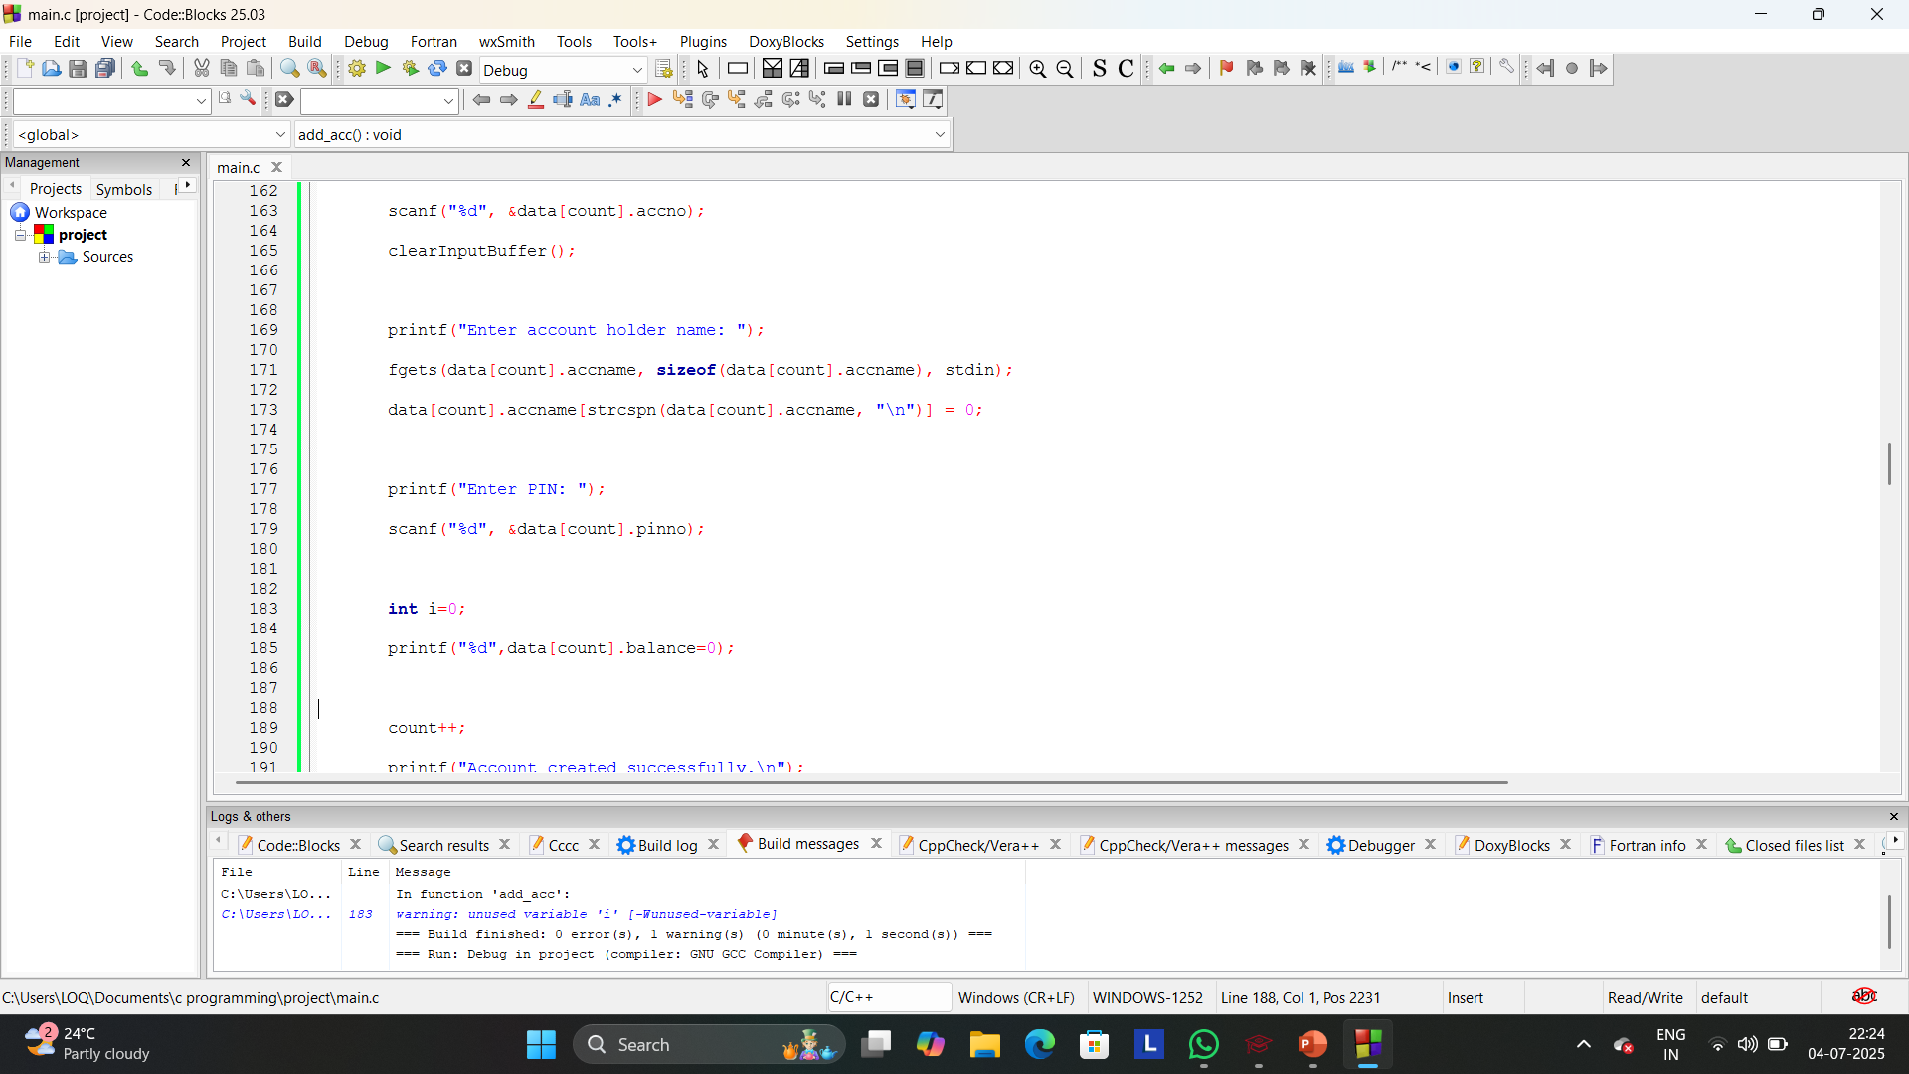

Slide 11
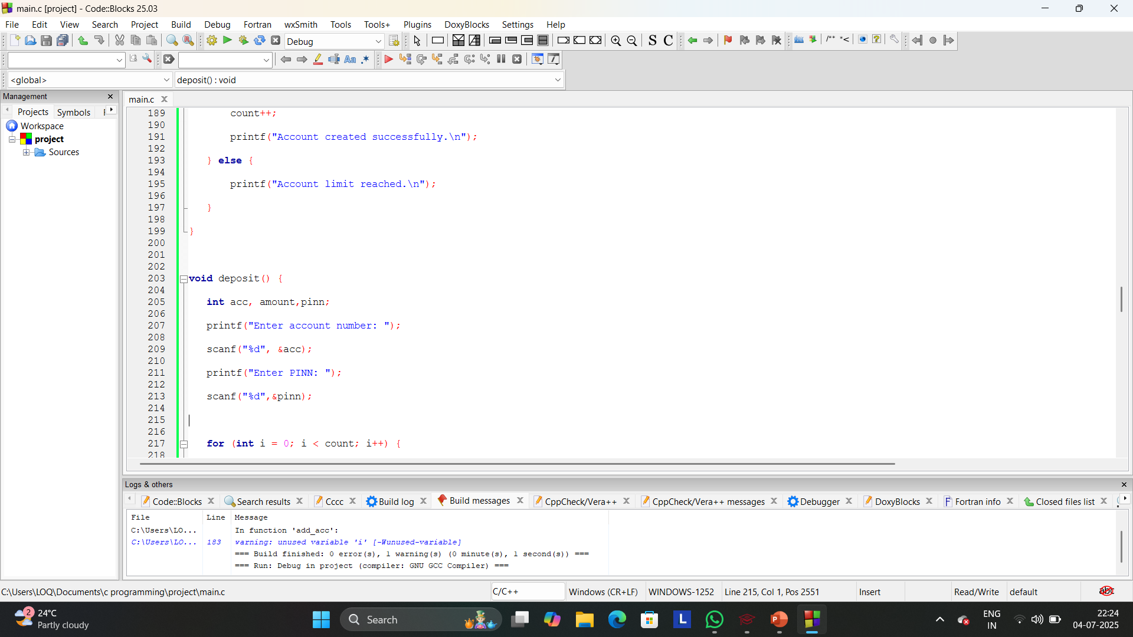

Slide 12
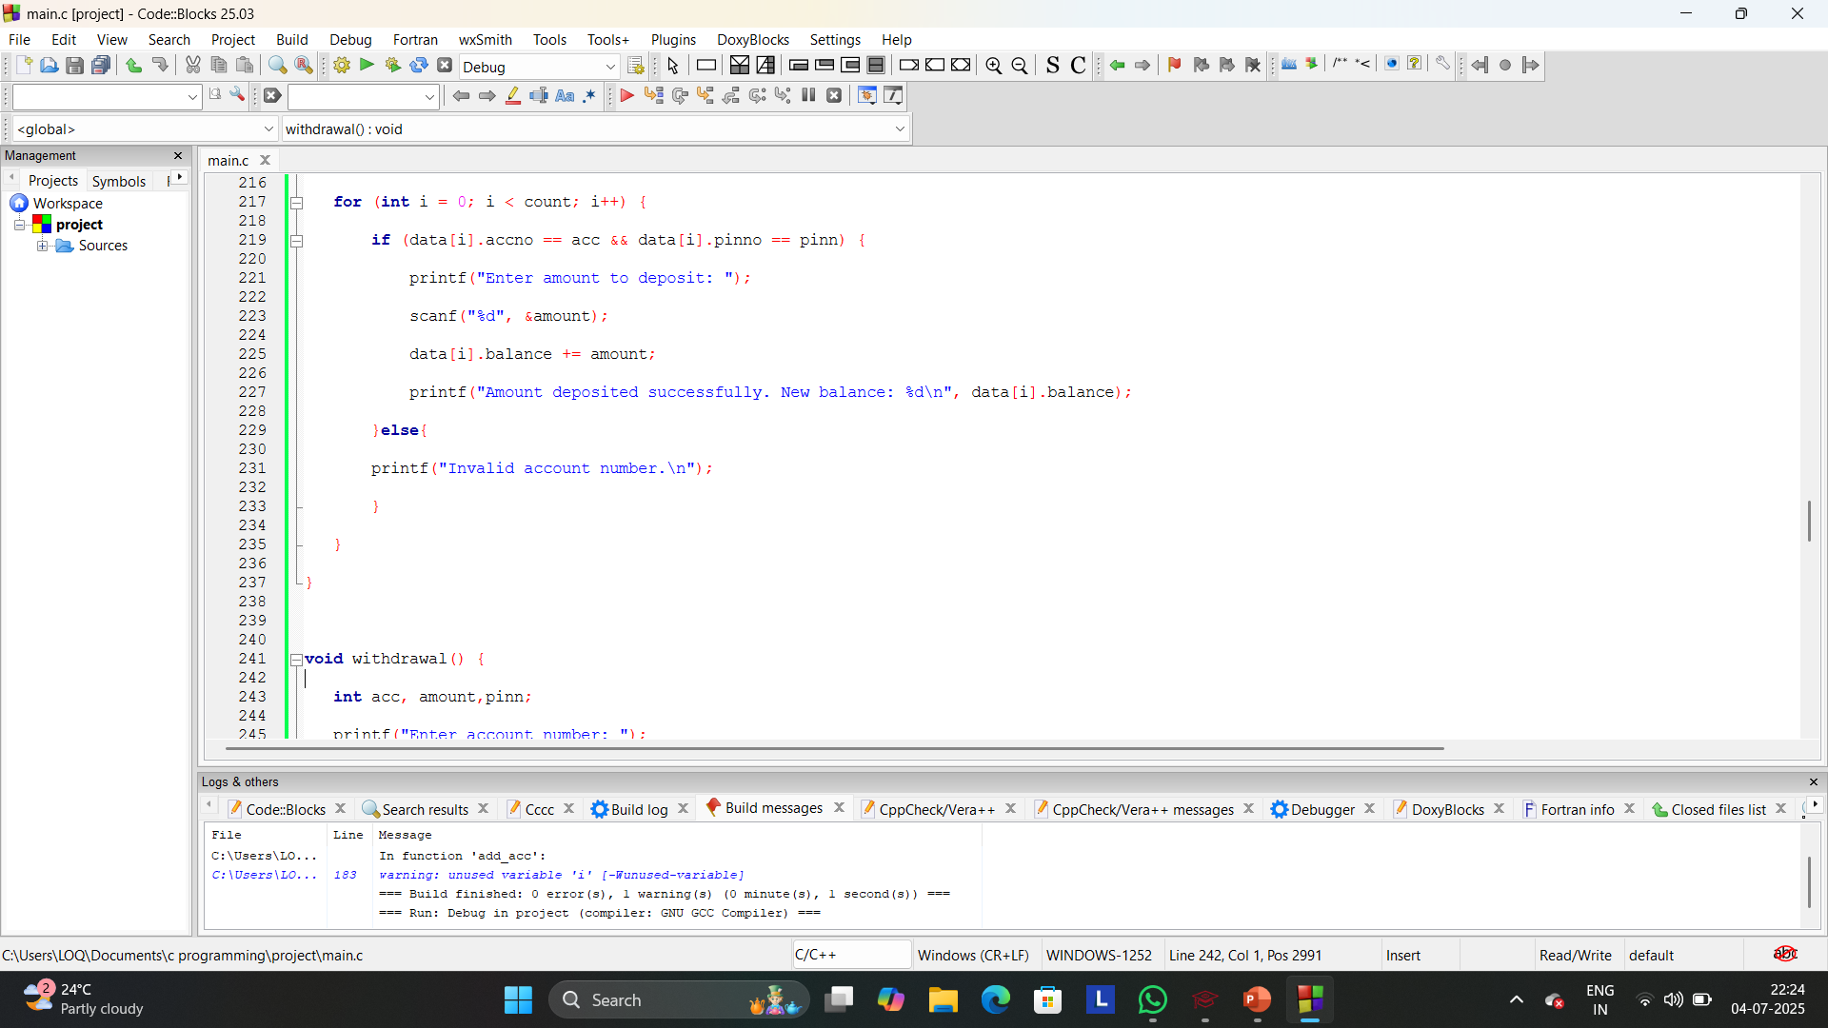

Slide 13
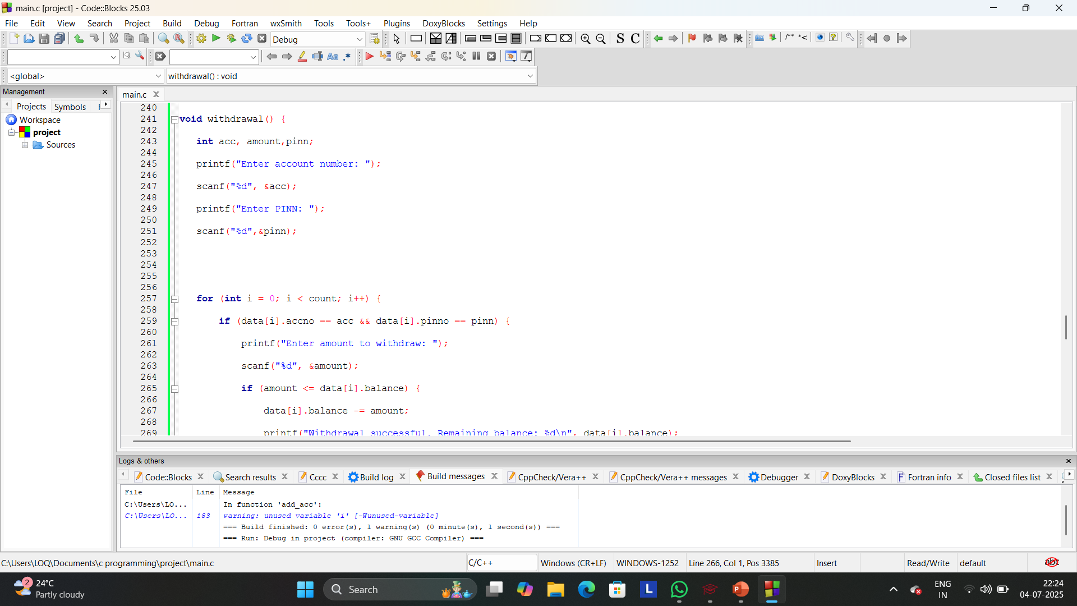

Slide 14
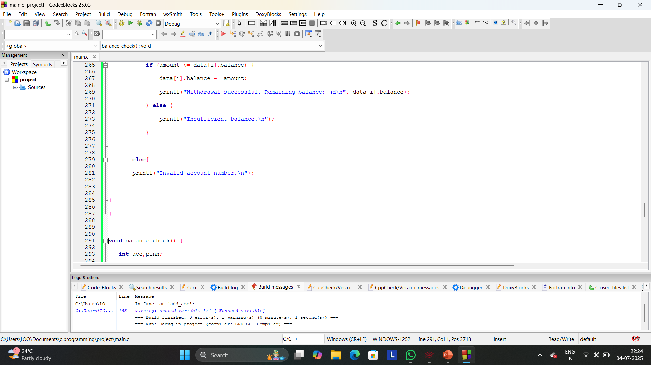

Slide 15
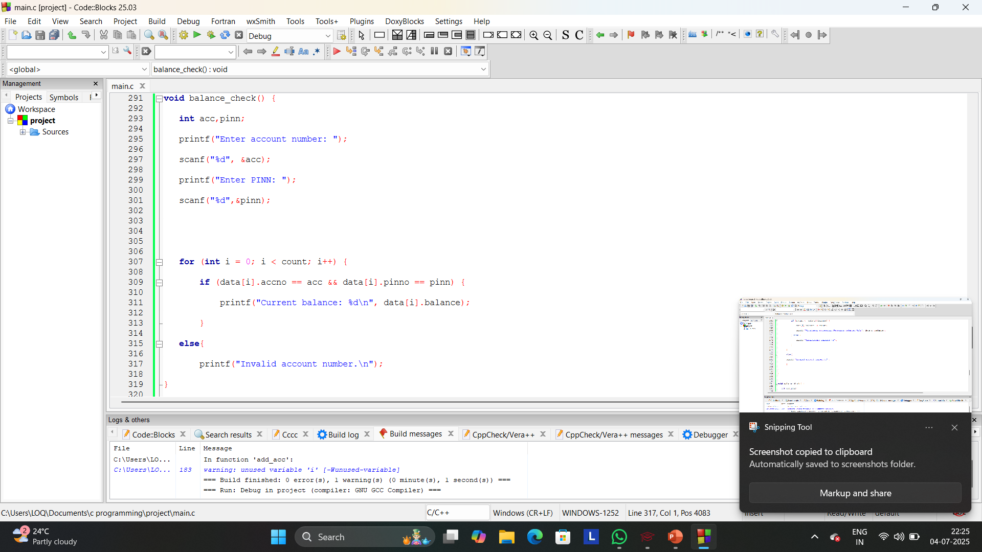

Slide 16
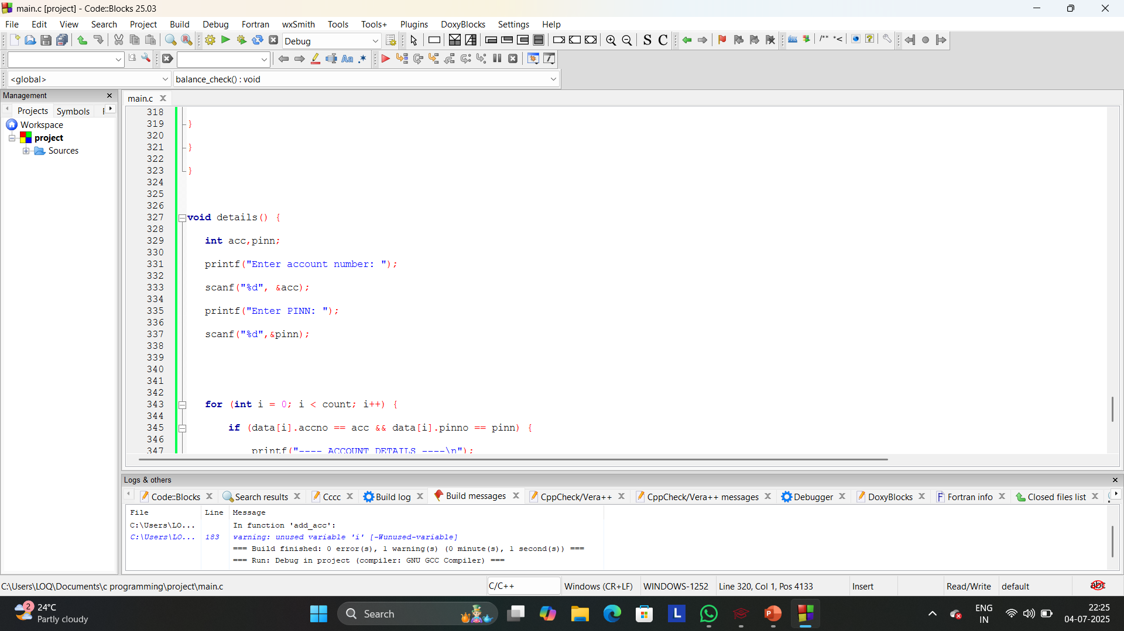

Slide 17
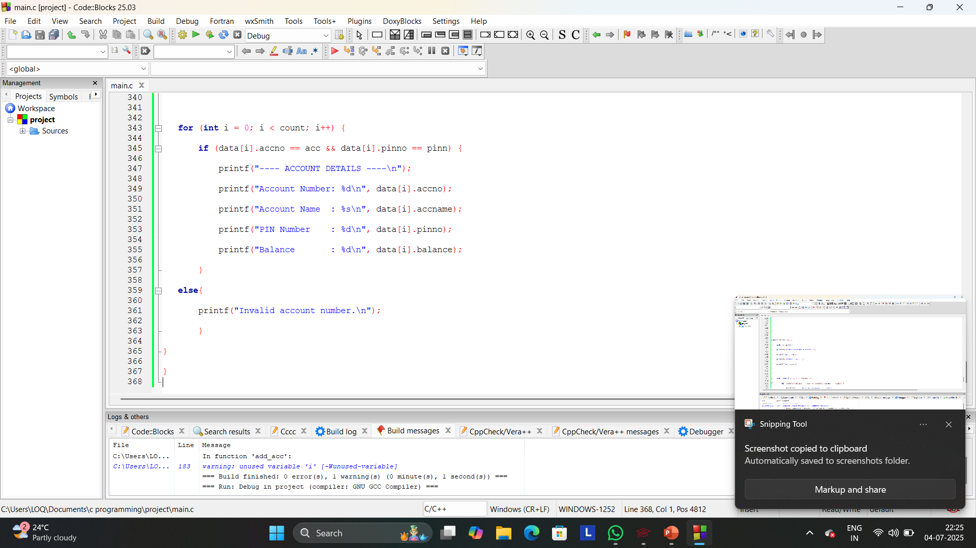

Slide 18
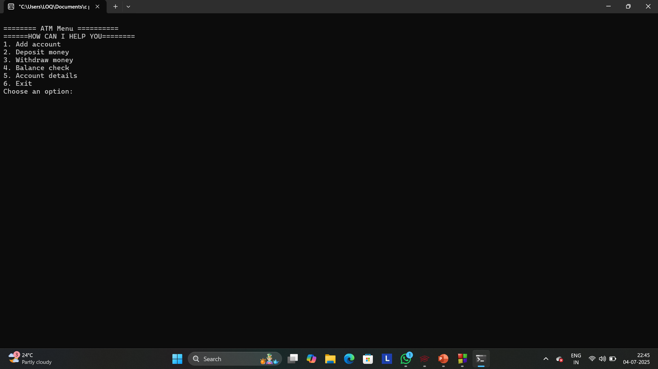
OUTPUT

Slide 19
CONCLUSION
The ATM Mini Project successfully demonstrates the basic functionalities of an Automated Teller Machine system using the C programming language. It includes essential operations such as account creation, balance inquiry, deposit, withdrawal, and account details viewing. The project helped us understand the application of structures, functions, arrays, and user input handling in a real-world simulation. Through this project, we gained practical experience in logic building, modular programming, and file handling (if used), which are foundational concepts in software development.
Overall, the project provided valuable insights into how banking systems work and strengthened our problem-solving and programming skills.

Slide 20
Codeblocks
www.gradskey.com

